Slide 1

CPE 490 Embedded Systems Lecture 21
dsPIC33F256GP710A ADC system
See section 16 of the family reference manual on Blackboard

Slide 2
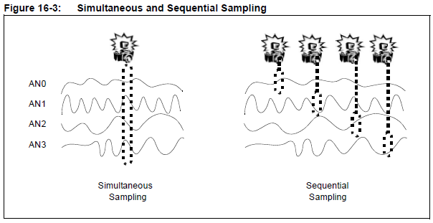
Sampling Mode
Up to 4 channels can be sampled simultaneously
Simultaneous sampling can be important in control and power calculations.
Notes:
You can configure how many sample and hold channels are going to be active for any mode. Choices are:
CH0 Only or
CH0, and CH1 or
CH0, CH1, CH2, and CH3
Remember in 12 bit mode there is only one sample and hold

Slide 3
ADC SFRs
ADxCON1 – ADxCON4 (various control #4 allocates DMA memory)
ADxCHS123: ADCx Input Channel 1, 2, 3 Select Register
ADxCHS0: ADCx Input Channel 0 Select Register
AD1CSSH: ADC1 Input Scan Select Register High
ADxCSSL: ADCx Input Scan Select Register Low
AD1PCFGH: ADC1 Port Configuration Register High
ADxPCFGL: ADCx Port Configuration Register Low
Notes:
The ADxPCFGH registers are to select the digital or analog function of the 32 ADC pins

Slide 4
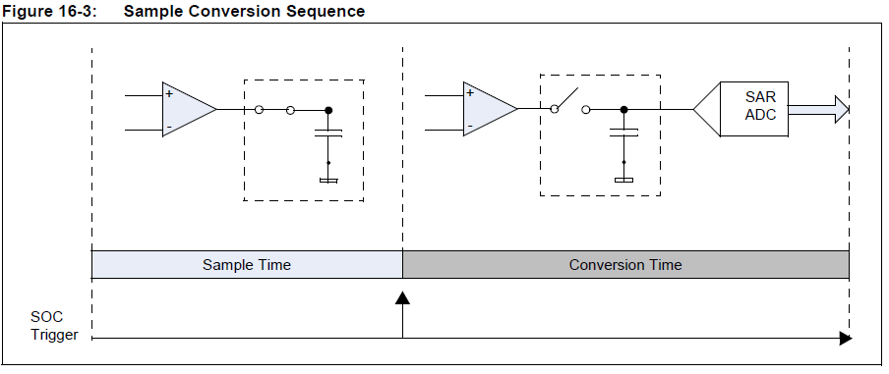
Overview of Sample and Conversion

Slide 5
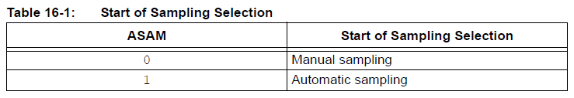
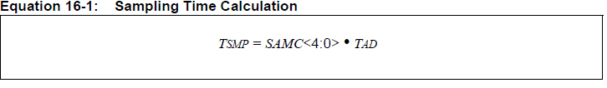
Sampling Initiation and Ending
Triggered by sampling ending
Notes:
To start manual sampling set the SAMP bit in the ADxCON1 and then go to hold by clearing the bit.
Caution there is a finite amount of sampling time that must be observed 3 Tad for 12 bit mode 2 Tad for 10 bit mode.
SAMC Auto sampling bits can be found in ADxCON4

Slide 6
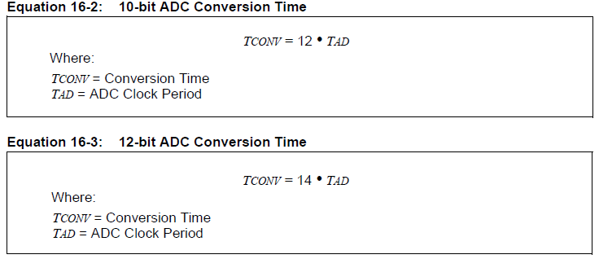
Conversion Time

Slide 7
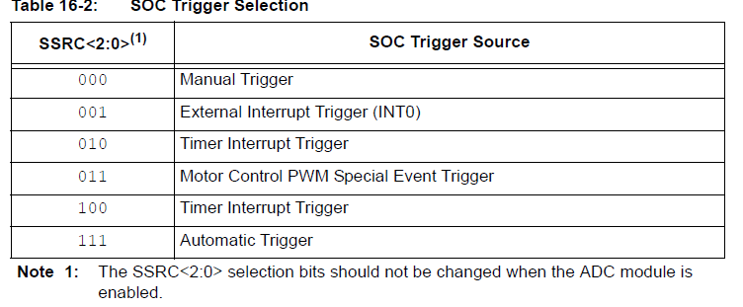
Conversion Initiation
Notes:
SSRC Sample Clock Source Select Bits (also called SOC Trigger Source Select bits) Found in ADxCON1

Slide 8
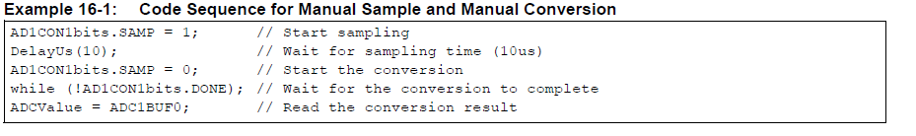
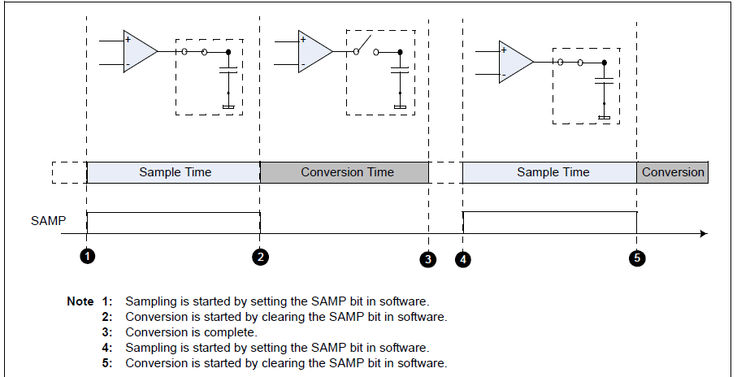
Manual Sample Manual Conversion
ASAM = 0, SSRC = 000

Slide 9
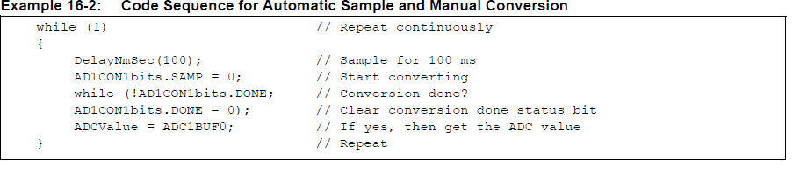
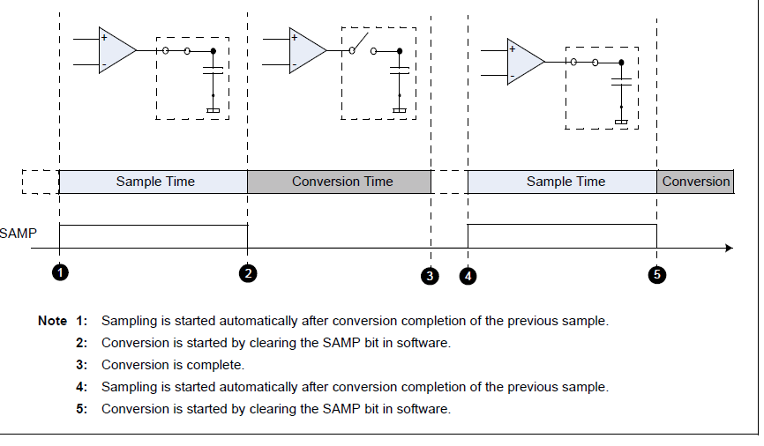
Auto Sample and Manual Convert
ASAM = 1, SSRC = 000 Sampling starts automatically right after conversion
Notes:
The only difference from manual / manual is that you don’t have to set the SAMP = 1

Slide 10
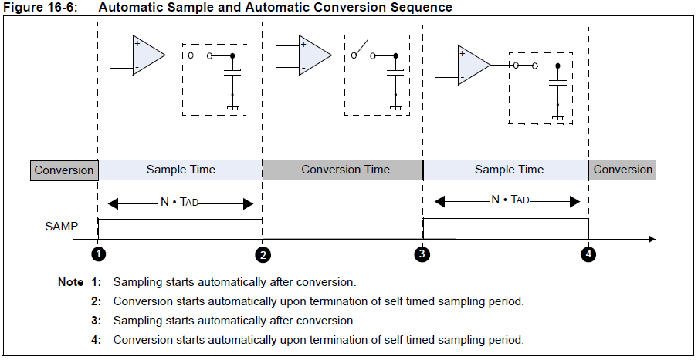
Auto Sample and Auto Convert
ASM = 1, SSRC = 111 Continuous periodic sampling
SAMC<4:0> select the sampling period; conversion occurs after sampling

Slide 11
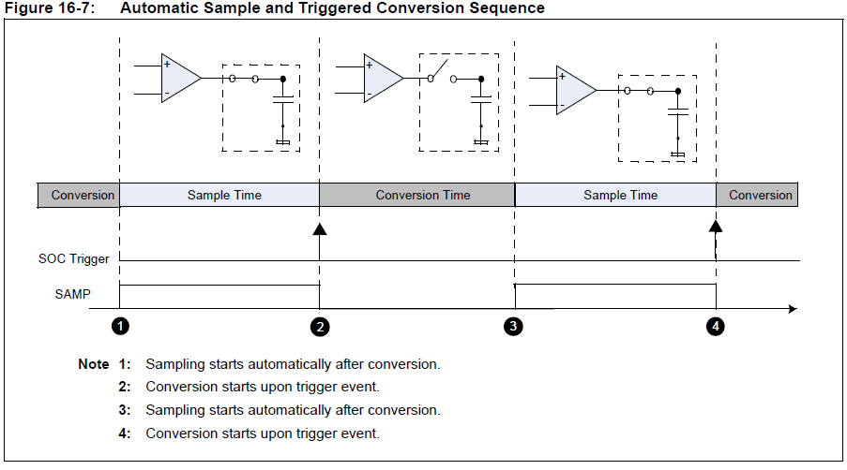
Auto Sample and Triggered Convert
ASM=1, SSRC = 001,010,011
Sample starts after conversion ends
Notes:
001 event external interrupt (INT0)
010, 100 Timer Interrupt Trigger
011 Motor Control PWM Special Event Trigger

Slide 12
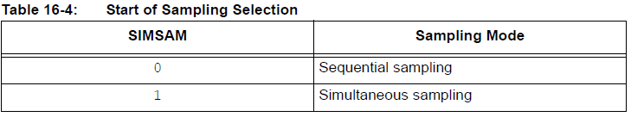
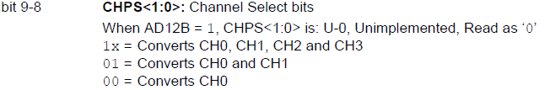
Sampling Mode Details
Notes:
Can’t do 12 bit simultaneous samples.
CHPS – Channel Select Bits found in ADxCON2

Slide 13
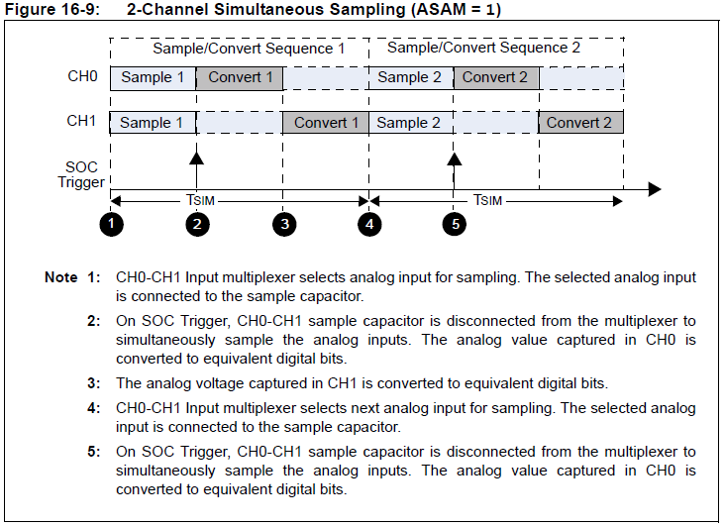
2 Channel Simultaneous Sampling
Notes:
It is important to notice the two sequence times. The multiplexers are set up to select the input channel for sample A then for Sample B

Slide 14
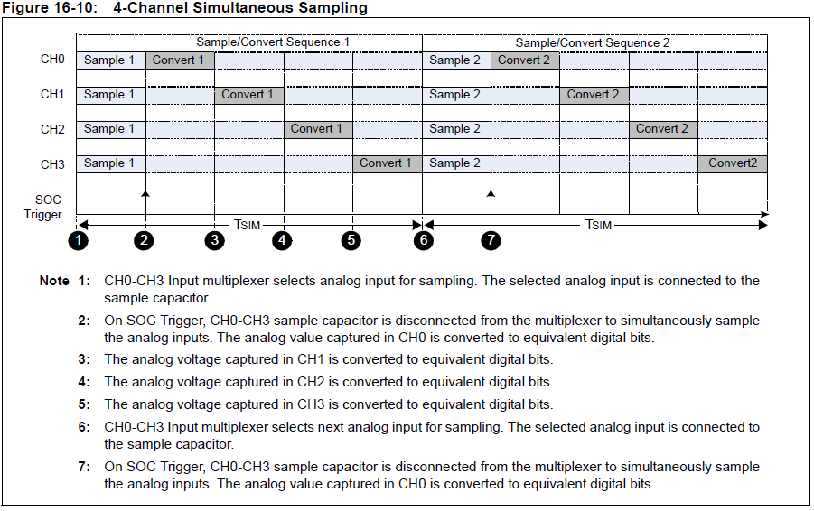
4 Channel Simultaneous Sampling

Slide 15
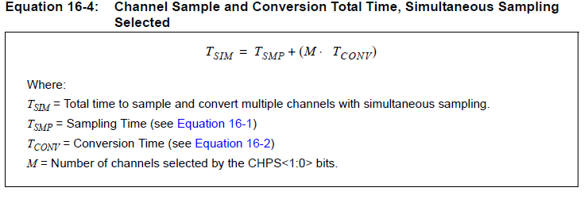
Total Time to Simultaneous Sample
Notes:
It is confusing but if the SSRC (SOC TRIGGER SOURCE) is not set to 111 automatic trigger, you must add 2 or 3 Tad (data sheet gives min and max)to the sampling time.

Slide 16
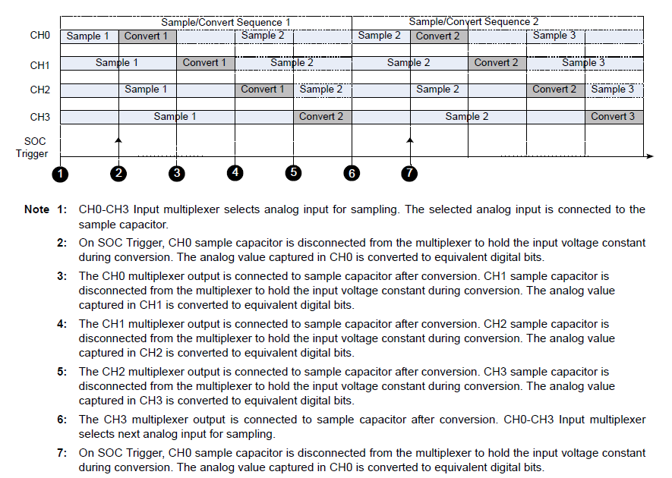
4 Channel Sequential Sampling

Slide 17
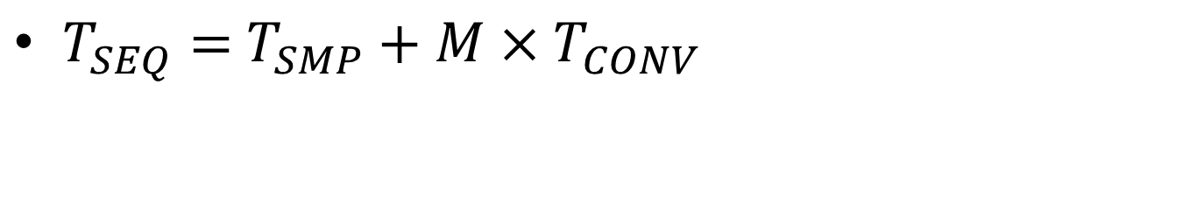
Total Time Sequential Sampling
$T_{SEQ}=$ $T_{SMP}+M×T_{CONV}$

Slide 18
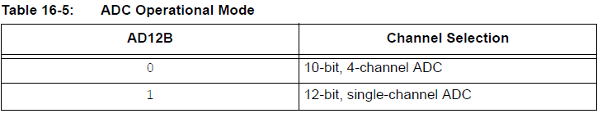
ADC Operation Mode
12 bit is slower
Simultaneous sampling only for 10 bit mode
If 12 bit mode only channel 0 can be active
AD12B is found ADxCON1

Slide 19
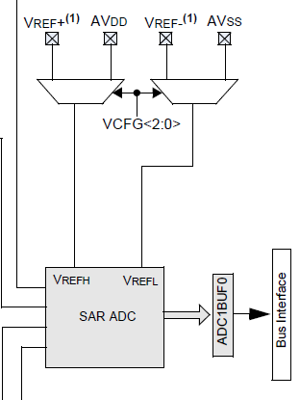
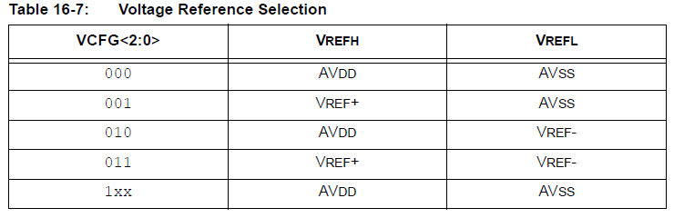
Voltage Reference
External voltage refrences can be used we will use the AV_{DD} and AV_{SS} that are connected to 3.3 and Ground respectively
Notes:
VCFG Voltage Reference Configuration Bits found in ADxCON2

Slide 20
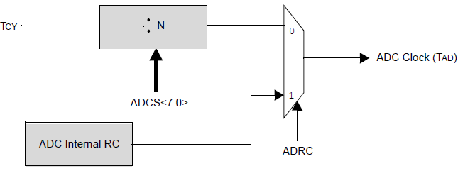
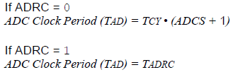
ADC Clock Generation
Internal RC has a frequency of 4 MHz nominally
Minimum period allowed is 75ns (13.3 MHz)
Notes:
ADCS A/D conversion clock bits even thought it is a 7 bit entry the large value allow is 0011 1111 = 3F = 63 These bits are located in ADxCON3
ARDC ADC conversion clock source bit located in ADxCON3

Slide 21
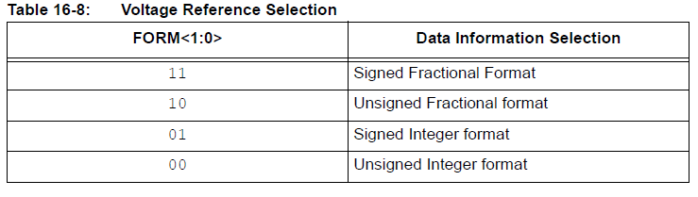
Output Data Format Selection
4 selection possible. 2 signed and 2 unsigned
FORM is found in ADxCON1

Slide 22
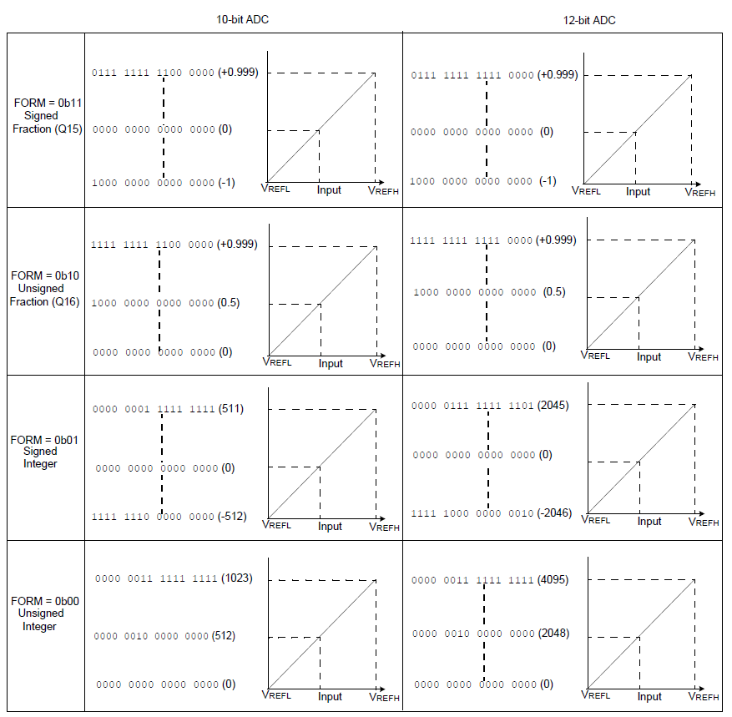
Notes:
We will unsigned integer format

